Slide 1
Data Analytics
Walmart E-Commerce

Slide 2
Business Scenario
Modeling the effects of markdowns on holiday weeks in the absence of complete/ideal historical data

Slide 3
Objectives
Which store has maximum sales
Which store has maximum standard deviation i.e., the sales vary a lot. Also, find out the coefficient of mean to standard deviation
Which store/s has good quarterly growth rate in Q3’2012
Some holidays have a negative impact on sales. Find out holidays which have higher sales than the mean sales in non-holiday season for all stores together
Provide a monthly and semester view of sales in units and give insights
Build prediction models to forecast demand

Slide 4
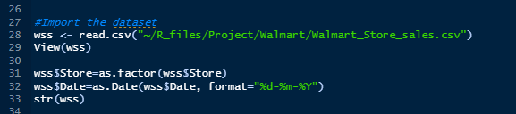
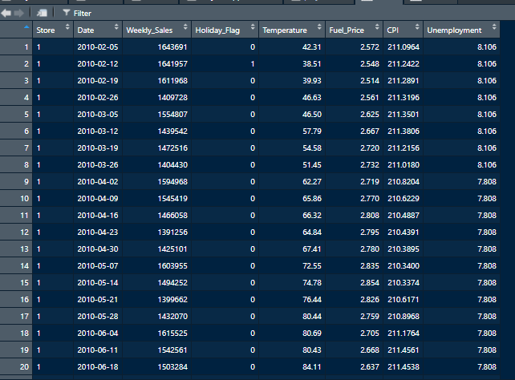
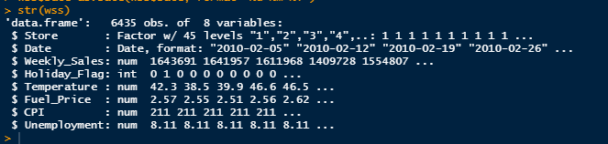
Data Availability
Ingest data, format Factors and Date type
Data Preview

Slide 5
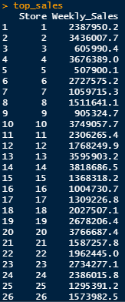
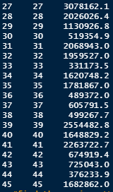

Data Exploitation: store with maximum sales
maximum Weekly Sales based on the Store category
maximum Weekly saLes
top_sales <- aggregate(Weekly_Sales~Store,data=wss,max)
top_sales
top_sales %>%
filter(Weekly_Sales == max(Weekly_Sales, na.rm = TRUE))

Slide 6
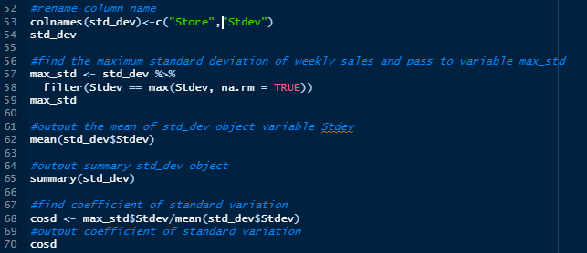
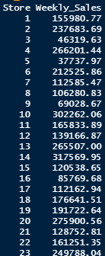
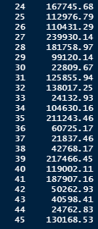

Data Exploitation - store with maximum standard deviation
standard deviation of Weekly sales
maximum standard deviation
std_dev <- aggregate(Weekly_Sales~Store,data=wss,sd)
std_dev

Slide 7
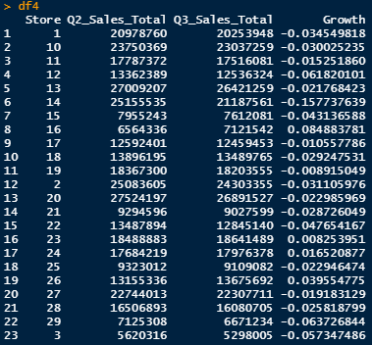
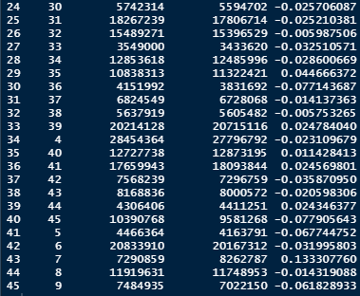
Data Exploitation - store with good quarterly growth rate in Q3’2012
Q2 VS Q3 2012 total sales growth
df4$Growth <- (df4$Q3_Sales_Total - df4$Q2_Sales_Total)/ df4$Q2_Sales_Total

Slide 8
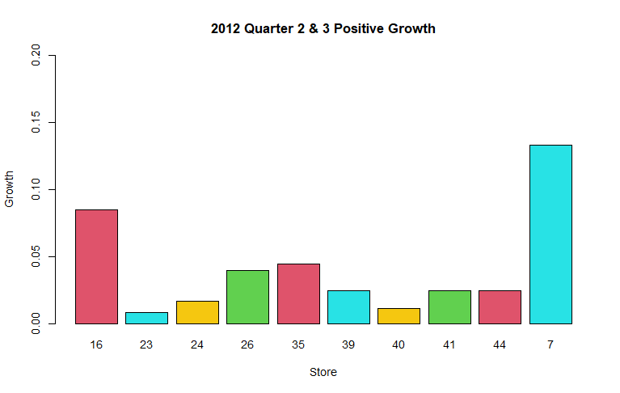
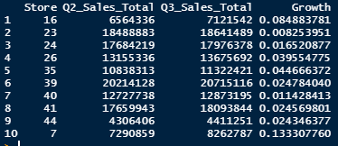
Data Exploitation - store with good quarterly growth rate in Q3’2012 (Cont.)
Positive growth
Positive Growth Graph
df5 <- df4 %>%
filter(Growth>0)
df5

Slide 9
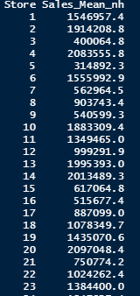
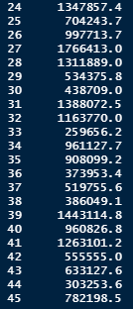
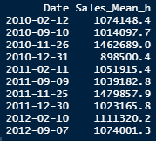
Data Exploitation - Holidays with higher sales than the mean sales in non-holiday season
non-holidays sales mean by store
HOLIDAY SALES MEAN BY DATE
nh_sm <- aggregate(Weekly_Sales~Store,data=nh_df,mean)
colnames(nh_sm)<-c("Store","Sales_Mean_nh")
hsd_sm <- aggregate(Weekly_Sales~Date,data=h_df,mean)
colnames(hsd_sm)<-c("Date","Sales_Mean_h")

Slide 10
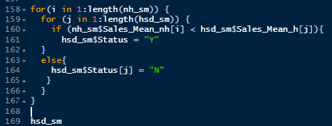
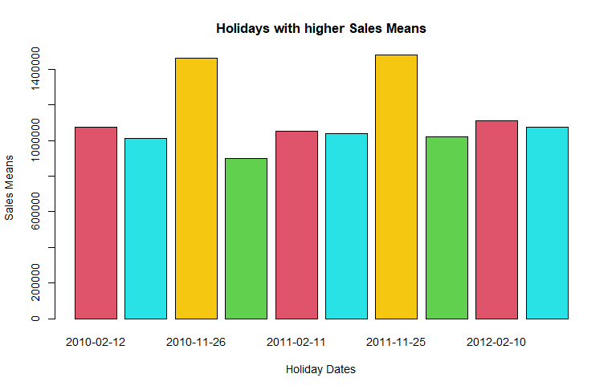
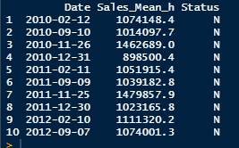
Data Exploitation - Holidays with higher sales than the mean sales in non-holiday season (Cont)
Get holidays with high sales mean
Holiday dates with higher means sales
hh_df <- hsd_sm %>%
filter(Status == "N")

Slide 11
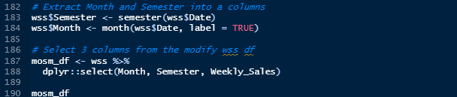
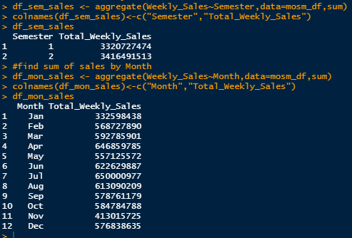
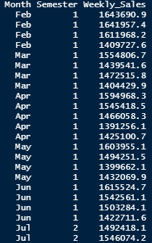
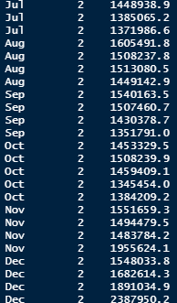
Data Exploitation - monthly and semester view of sales
Month & semester sales
Total sales by Semester & month
[reached 'max' / getOption("max.print") -- omitted 6102 rows ]

Slide 12
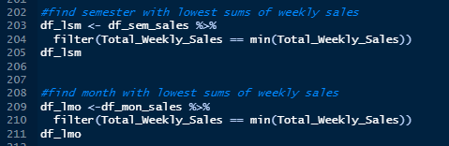
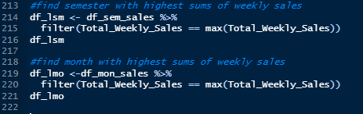
Data Exploitation - monthly and semester view of sales (cont.)
Month & semester with lowest sales
Month & semester with highest sales
Semester Total_Weekly_Sales
1 3,320,727,474
Month Total_Weekly_Sales
Jan 332,598,438
Semester Total_Weekly_Sales
2 3,416,491,513
Month Total_Weekly_Sales
Jul 650,000,977

Slide 13
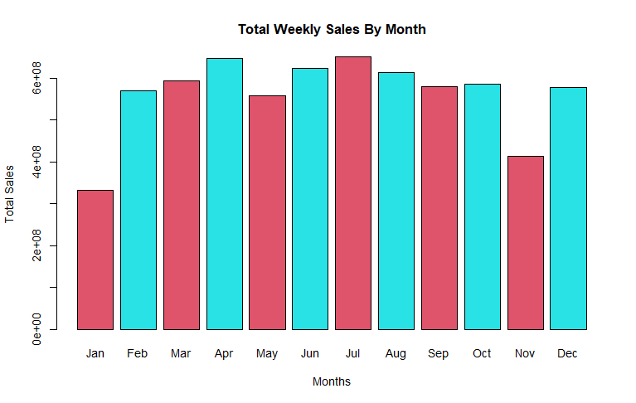
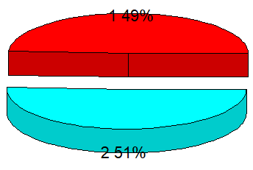
Data Exploitation - monthly and semester view of sales (cont.)
Total Weekly Sales by month
Total Weekly Sales by semester

Slide 14
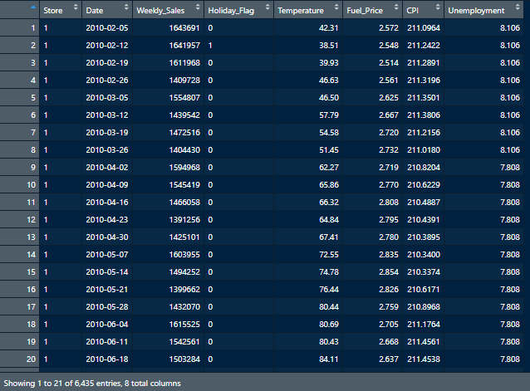
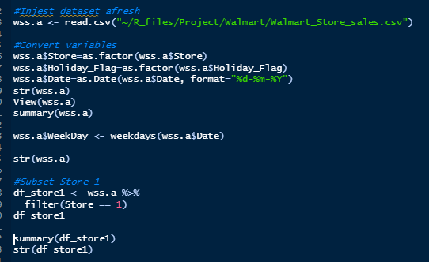
Statistical Modeling - Data Preparation
Prepare date and subset store 1
Store 1

Slide 15
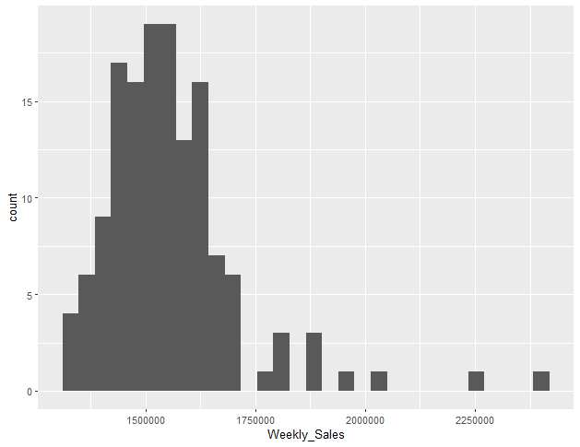
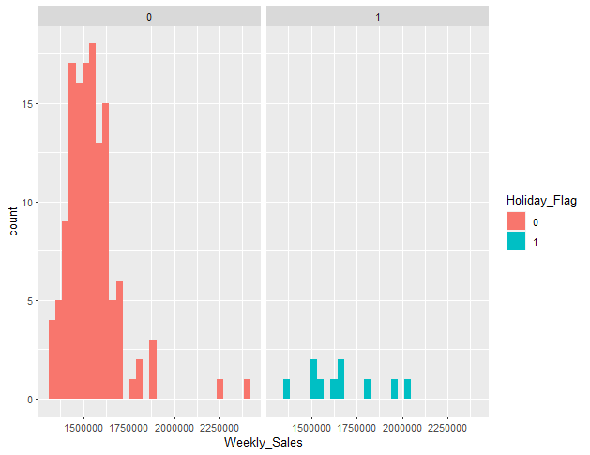
Statistical Modeling - Visualization
Weekly Sales
Weekly Sales showing Holiday

Slide 16
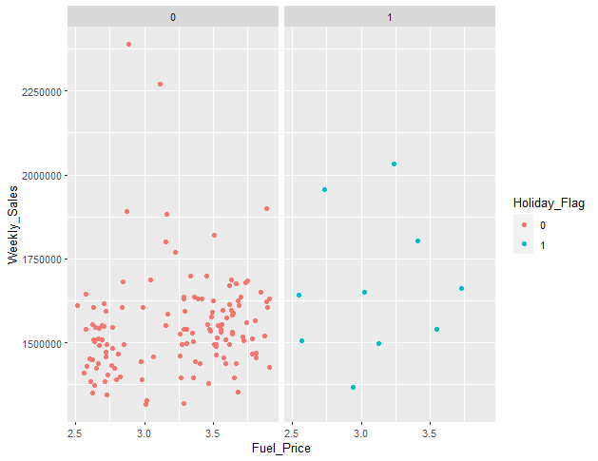
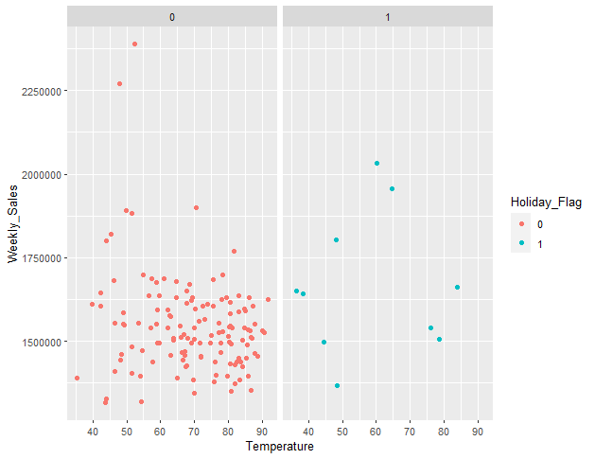
Statistical Modeling - Visualization
Weekly Sales vs Fuel Price on holidays and non-holidays
Weekly Sales vs Temperature on holidays and non-holIdays

Slide 17
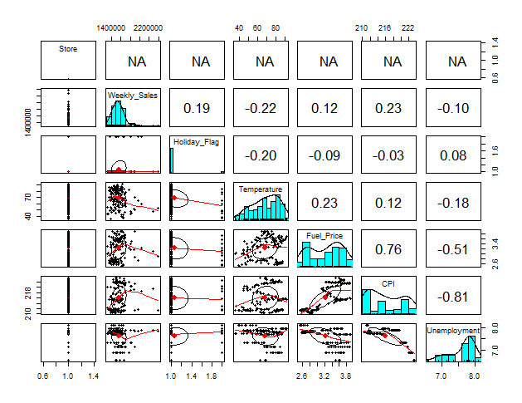
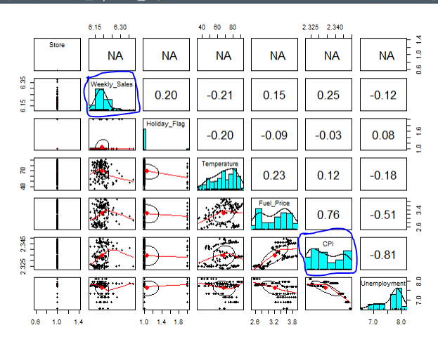
Statistical Modeling - Transforming Predictors: Visualization
Without transformation
With transformation

Slide 18
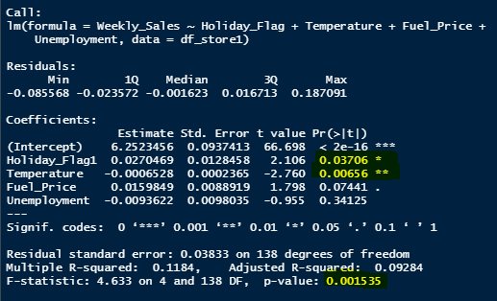

Statistical Modeling - Fitting the Models
Model 1
Summary
fit1=lm(Weekly_Sales~Holiday_Flag+Temperature+Fuel_Price+Unemployment, data=df_store1)
summary(fit1)
vif(fit1)
Multicollinearity of predictors

Slide 19
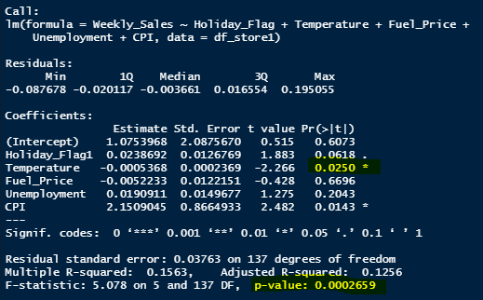

Statistical Modeling - Fitting the Models
Model 2
Summary
fit2=lm(Weekly_Sales~Holiday_Flag+Temperature+Fuel_Price+Unemployment+CPI, data=df_store1)
summary(fit2)
vif(fit2)
Findings: Increased multicollinearity across board while including as a predictor
Findings: Including CPI in the predictors reduced the significance of Temperature and decreases the P-value

Slide 20
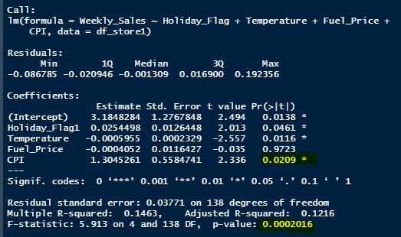

Statistical Modeling - Fitting the Models
Model 3
Summary
fit3=lm(Weekly_Sales~Holiday_Flag+Temperature+Fuel_Price+CPI, data=df_store1)
summary(fit3)
vif(fit3)
Findings: Reduced multicollinearity across board while removing Unemployment as a predictor
Findings: Removing Unemployment as a predictor slightly increases the significance of CPI Index and decreases the P-value

Slide 21
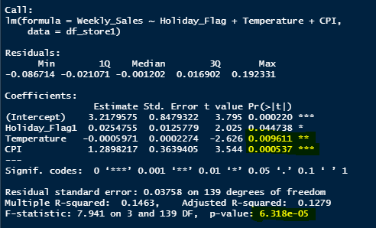

Statistical Modeling - Fitting the Models
Model 4
Summary
fit4=lm(Weekly_Sales~Holiday_Flag+Temperature+CPI, data=df_store1)
summary(fit4)
vif(fit4)
Findings: Reduced multicollinearity in this models for Temperature and CPI predictors also supports the effectiveness of the model above others
Findings: Removing Unemployment and Fuel Price as predictors increases significance of Temperature and CPI Index and also brings the P-value to the lowest level, indicating this as the Most Effective.

Slide 22
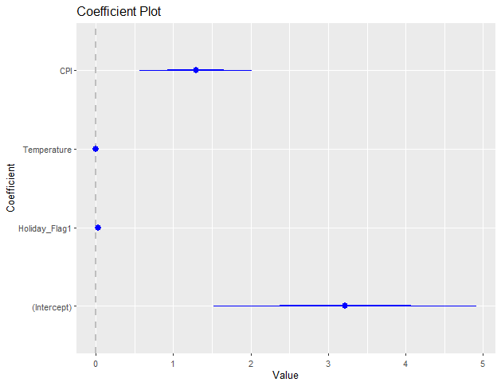
Statistical Modeling - Fitting the Models
Model 4 NOTE
All the predictors are signification but CPI s most significant
We can reject the null hypothesis that says the model has no significant predictor based on the P-vlue of the Overall F-test which tells us that our model is effective even though it might not be the best.

Slide 23
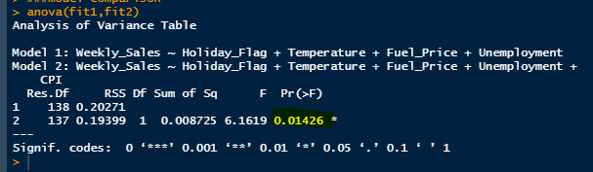
Statistical Modeling - Model Comparison with Analysis of Variance
Model 1 vs 2
NOTE
Model 2 (Fit2) that include the CPI predictor is slightly better than Model 1.
High p-value means the CPI predictor is not however significant to completely reject the null hypothesis that says..
Fit1 model is as well as Fit2

Slide 24
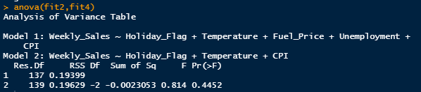
Statistical Modeling - Model Comparison with Analysis of Variance
Model 2 vs 4
NOTE
High p-value means we cannot reject the null hypothesis that says
Model 2 is as well as Model 4
Unemployment as predictor had no significance.

Slide 25
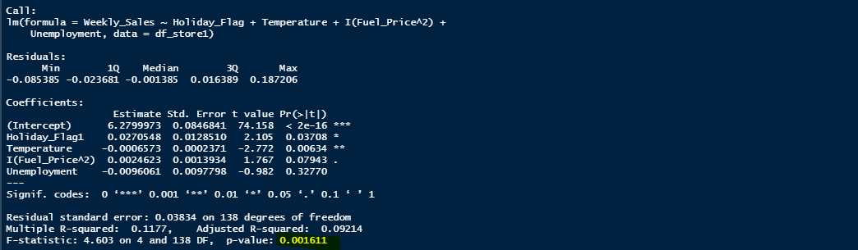
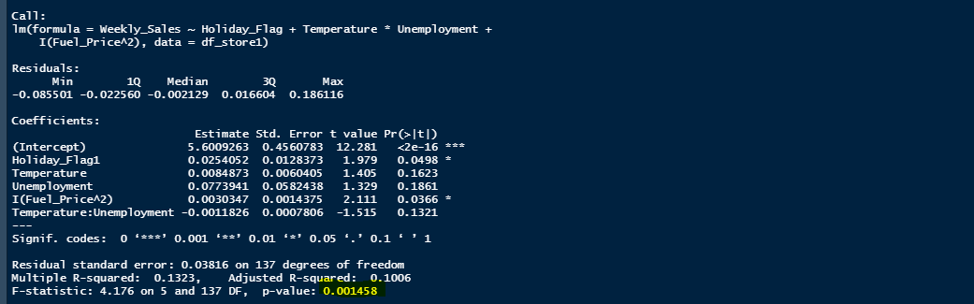
Statistical Modeling - Add Interaction to Predictors
Model 5 and 6
fit5=lm(Weekly_Sales~Holiday_Flag+Temperature+I(Fuel_Price^2)+Unemployment, data=df_store1)
summary(fit5)
fit6=lm(Weekly_Sales~Holiday_Flag+Temperature*Unemployment+I(Fuel_Price^2), data=df_store1)
summary(fit6)
NOTE
The interaction makes not much difference on the predictors
High p-value means we cannot reject the null hypothesis that says..
Fit5 model is as well as Fit6 - Different interactions on Unemployment and Fuel Price as predictor had no significance

